Slide 1
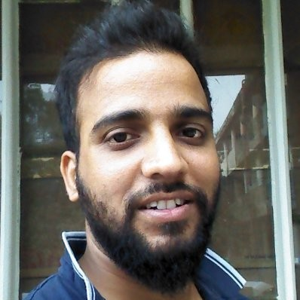

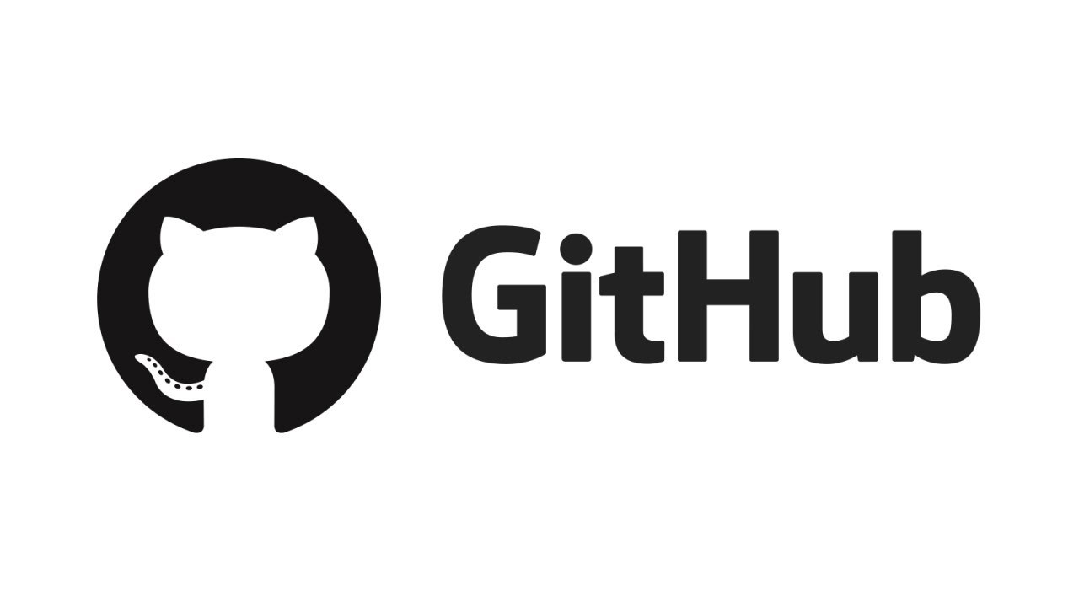


Data Science with Python
Sajjad Hussain
@saz2nitk
https://github.com/saz2nitk
https://www.linkedin.com/in/sajjad-hussain-86188816/
saz2nitk@gmail.com

Slide 2
Who am I?
Data Science Lead, REM, Trafigura
Former Co-founder at Heuristech Labs
Full Stack Data Scientist
Experience
Data Science
Fintech
NLP
E-commerce
Structured & Unstructured Data

Slide 3
What will we cover
Will you become a Full Stack Data Scientist after this session?
No
What do we achieve then?
You’ll learn how to become a Data Scientist
You’ll know if Data Science interests you
Major Topics
Fundamentals of Data Science
Python Programming
Some Machine Learning Algorithm
Implementing one Data Science Solution

Slide 4
What is Data Science
Data Science vs Data Analysis
There is a fundamental difference between the two terms
What do Data Scientists do?
Solve Problems
Day-to-day Activity
Talk to business, understand problem
Analyse data and find useful insights
Build models, Deploy and Maintain them

Slide 5

Major Skills

Slide 6
Skillset
Programming
Python
Tools
Numpy
Mathematics
Deployment
Machine Learning
Classification
R
Scala
Java
C/C++
NLTK
CoreNLP
Rapid Miner
Weka
TextBlob
Spacy
Tensorflow
Probability
Calculus
Vectors
Statistics
Clustering
Regression
Anomaly Detection
Recommender System
Pattern Matching
Computer Vision
API
Linux
Cloud Services
AWS/Azure/IBM
Docker
Kubernetes
Big Data
Hadoop
Spark

Slide 7
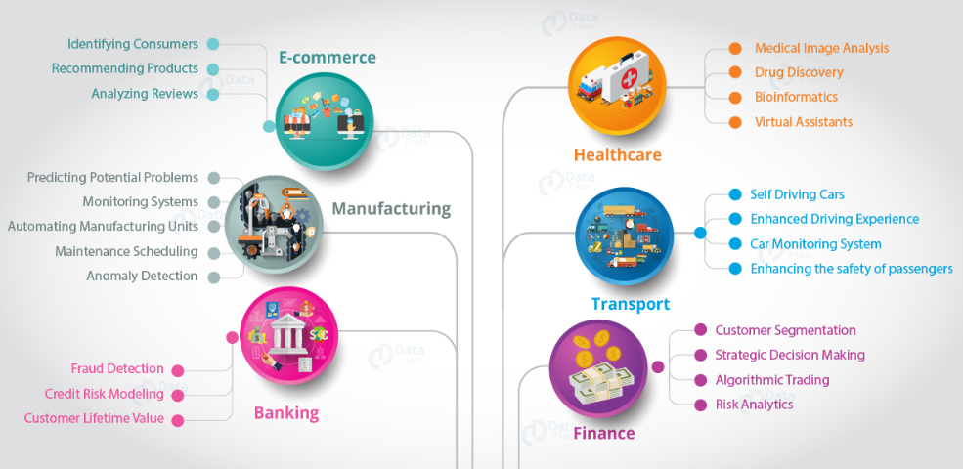
Data Science Applications

Slide 8
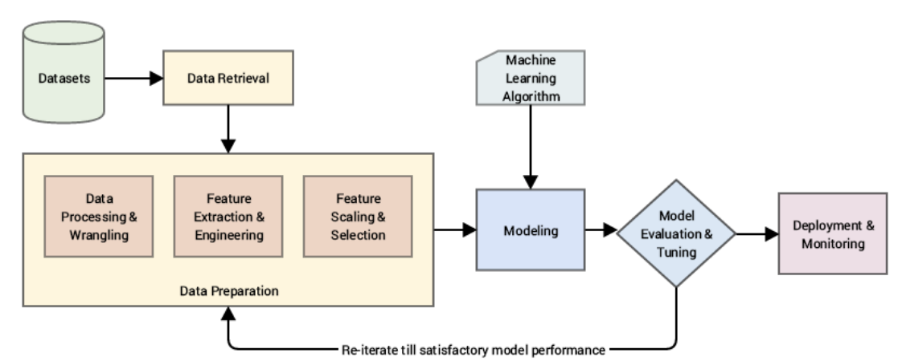
Machine Learning Pipeline

Slide 9
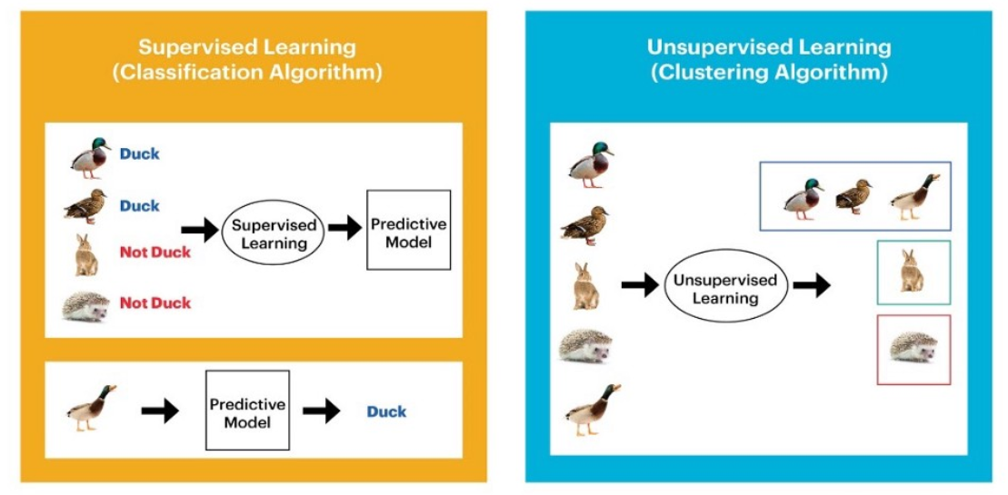
Machine Learning Algorithms/Models

Slide 10
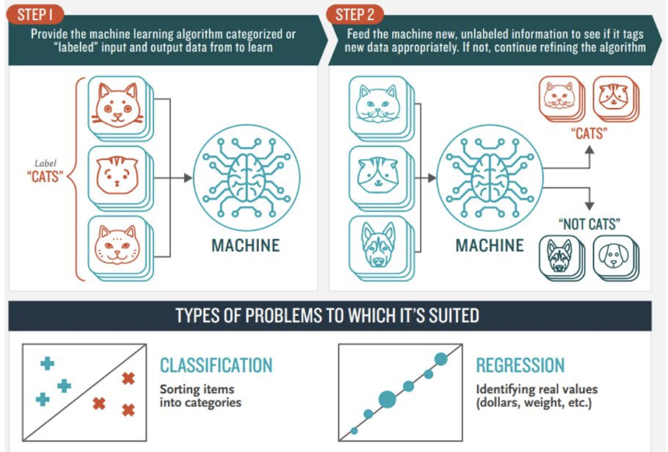
Supervised Learning

Slide 11
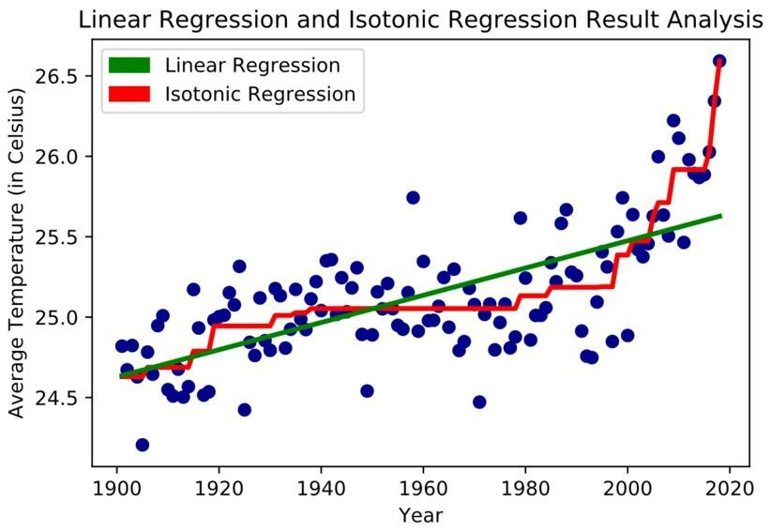
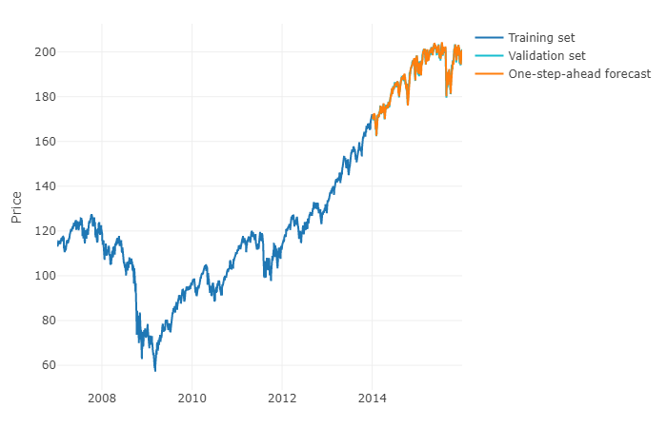
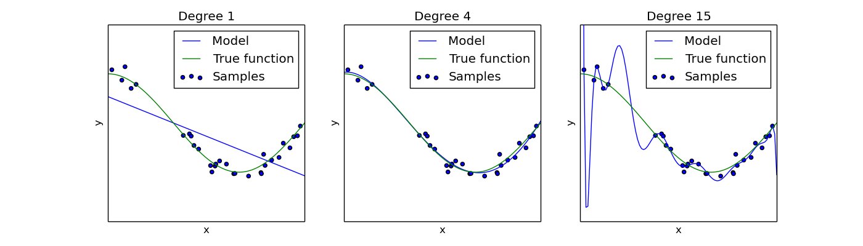
Regression

Slide 12
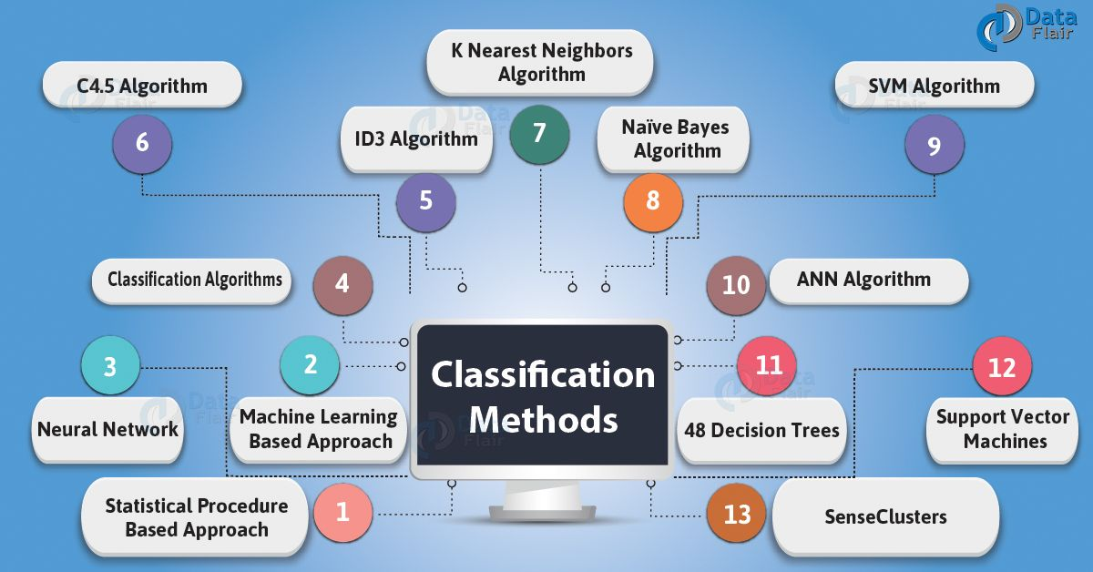
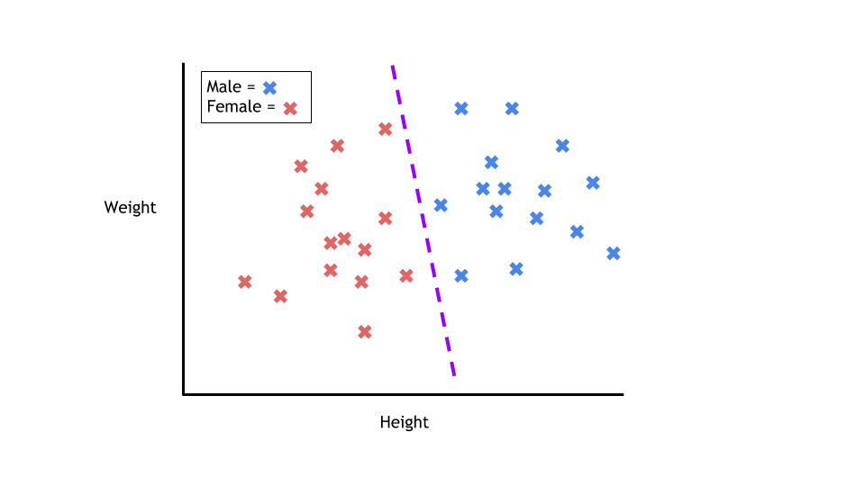
Classification

Slide 13
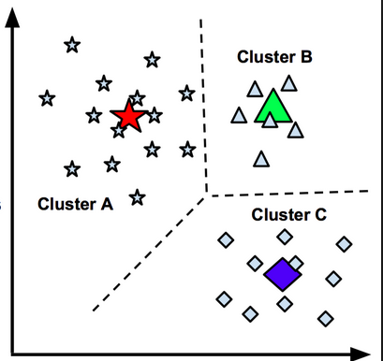
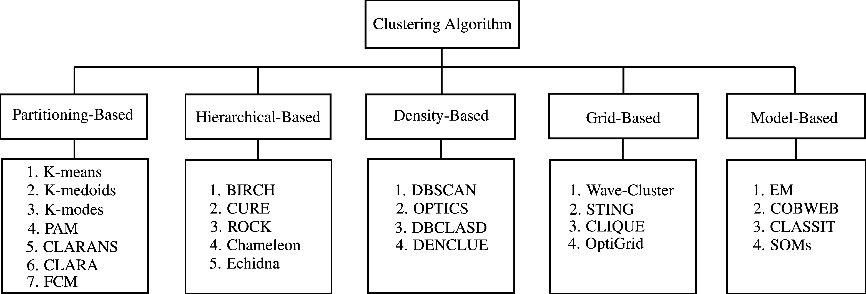
Clustering

Slide 14
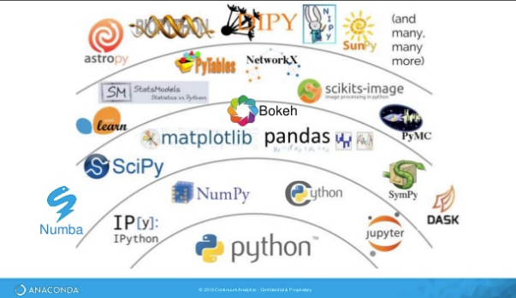
Data Science Libraries

Slide 15



Lets do some real work now
@account

